Slide 1
Kautex - KBSH 2-60

Slide 2
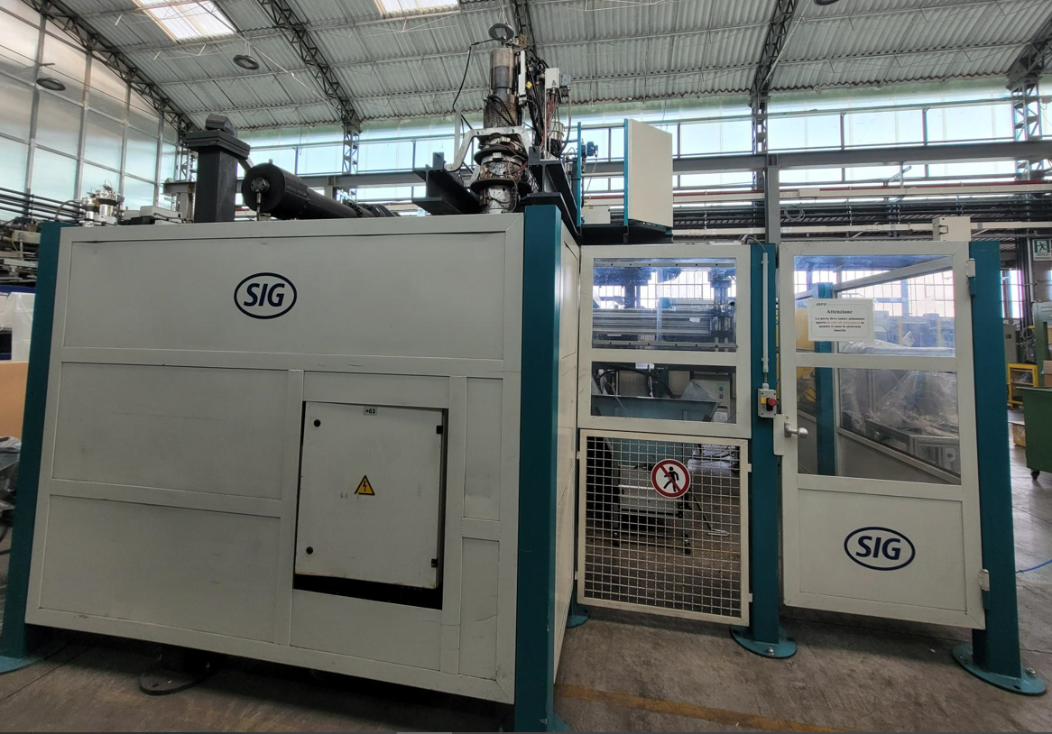
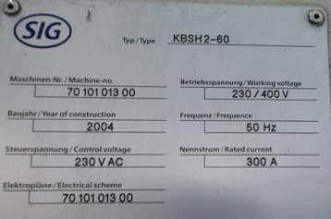
General information
Description | Value
Year of costruction | 2004
Working hours | 48.930 h
Dimensions mould holder plat
Width | 900 mm
Lenght | 1.200 mm
Dimension mould
Width maximum | 900 mm
Thickness mould minimum | 625 mm
Height mould maximum | 1.700 mm
Weight mould maximum | 4.000 kg
General dimensions of the machina
Lenght | 7.750 mm
Width (without control cabinet) | 4.400 mm
Height | 5.500 mm
Widht control cabinet (for free position) | 2.400 mm

Slide 3
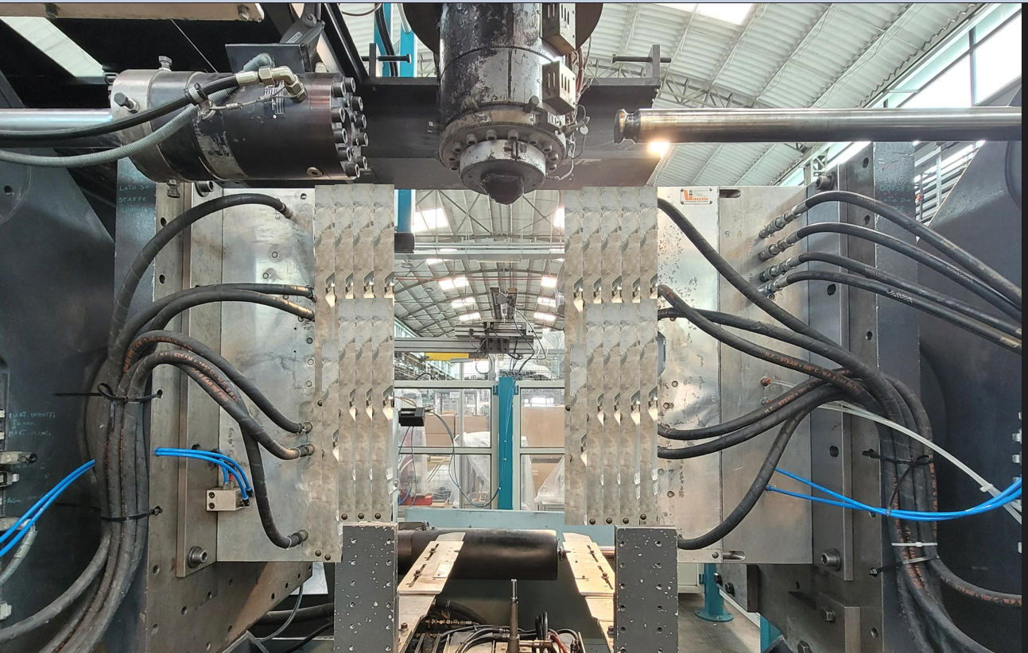
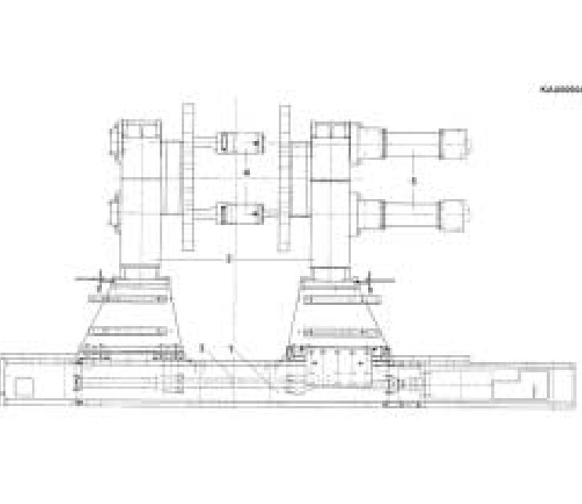
Clamping unit
The clamping unit consists of a base frame and a front and rear end plate support.
The opening and closing of the support plates, are carried out by an electric motor through a sphere's recirculation transmission.
Description | Value
Tonnage | 60 Ton
Tool min. thickness | 625 cm
Clamping unit max opening | 1.450 mm
Column passage | 900x1200 mm
Confidential

Slide 4
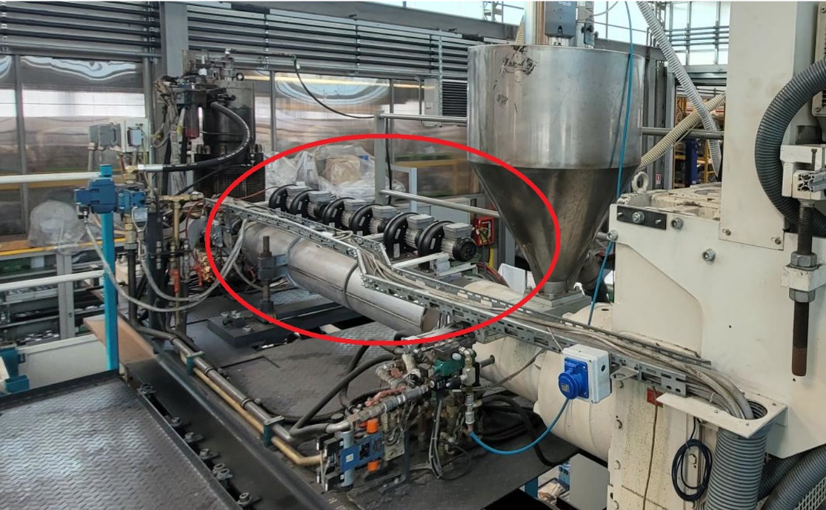
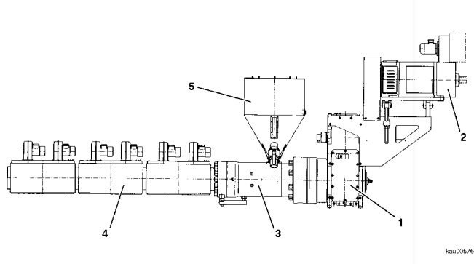
Extrusion unit
Description | Value
Cylinder number | 1
ø Screw | 100 mm
L/D | 25
Electric motor power | 81 kW
Heating power (380/415 V) | 18/21,6 kW
Turbofan power | 0,72 kW
N° controlled temp. zones | 3
ø Cooling water connection | R 1/2 in
∆p Cooling water | 4 bar
Cooling water | 5-6 C°
Extruder weight (whit motor) | 2.500 kg
Filling oil gearbox | 70 l
Oil gearbox type | CLP ISO VG 320

Slide 5
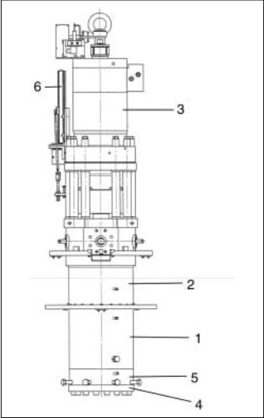
Accumulation head - BFKS 6,3
Description | Value
Theoretical quantity of ejected material @ 100 l/min with HDPE | 1,28 kg/s
Piston stroke | 220 mm
Refueling weight with HDPE | 4,7 kg
Small | min. 50 mm
 | max. 220 mm
Big | min. 85 mm
 | max. 300 mm
Thermoregulation zone | 4
Total heigh | 2021 mm
Weight | 1.040 kg

